Slide 1
Module 7 - Forms and Validation User Input • Validation • UX • Async Checks
Notes:
Introduce this module as the bridge between UI and real-world data. Everything users type into your app will go through forms and validation.

Slide 2
Contents
Build forms using Form and TextFormField
Use FormState and GlobalKey to validate and save data
Apply built-in and custom validation rules
Manage focus and keyboard interactions
Design user-friendly error messages
Implement a complete signup form with validation
This module leads into Module 8 – API Networking
Notes:
References
Mastering Flutter 2025
Chapter 4 – Basic Widgets (input fields, buttons)
Chapter 14 – Handling User Input & Gestures
Chapter 6 – State Management (supporting concepts)

Slide 3
Why Forms Matter
Why forms are critical in apps:
Common use cases:
Login / Signup
Profile update
Feedback & contact forms
Booking and checkout
Search and filtering inputs
If forms are done poorly:
Users submit invalid or incomplete data
Users get frustrated and abandon the app
Security and data quality issues appear
Key idea: Good apps = good forms + good validatio
Notes:
You could ask the class: “Have you ever abandoned an app because of an annoying input form?”

Slide 4
Input Widgets Overview
Core input widgets in Flutter
TextField – basic text input
TextFormField – text input with validation in a form
Checkbox, Switch, Radio – boolean choices
DropdownButton – pick from a list of options
Date & time pickers – select from dialogs
When to use which?
Use TextField for simple, one-off inputs
Use TextFormField inside a Form when you need validation
Notes:
Note that in this subject, when we say “form”, we almost always use TextFormField.

Slide 5
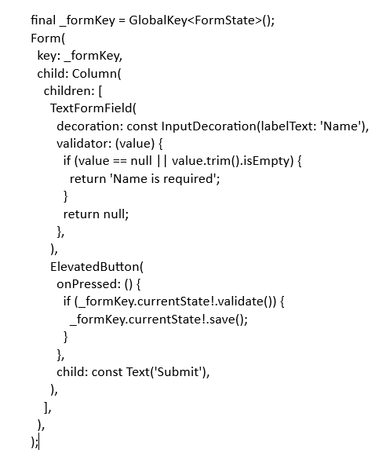
Form & FormState
What is a Form?
A Form groups multiple input fields
A GlobalKey<FormState> lets you:
Validate all fields at once
Save all field values
Reset the form
Core methods:
formKey.currentState!.validate()
formKey.currentState!.save()
formKey.currentState!.reset()
Notes:
Demo: show students the real Form.

Slide 6
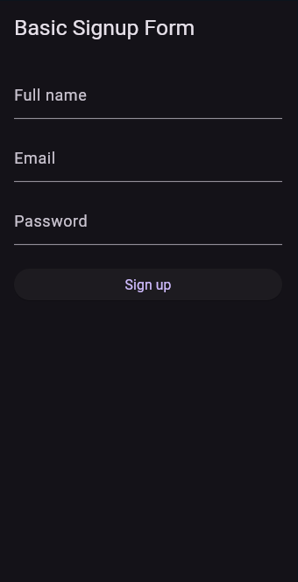
Demo 1- Basic Signup Form
Goal: Create a simple signup form using Form + TextFormField.
Requirements
Fields: Name – Email – Password
All fields required
Email must contain @ and .
Password ≥ 6 characters
Submit Behavior
validate() → show inline errors
If valid → show SnackBar: “Signup successful”
Notes:
Code demo: Lab 7.1
import 'package:flutter/material.dart';
void main() => runApp(const Lab7_1App());
class Lab7_1App extends StatelessWidget {
const Lab7_1App({super.key});
@override
Widget build(BuildContext context) {
return MaterialApp(
title: 'Lab 7.1 – Basic Form',
theme: ThemeData.dark(useMaterial3: true),
home: const BasicSignupScreen(),
debugShowCheckedModeBanner: false,
);
}
}
class BasicSignupScreen extends StatefulWidget {
const BasicSignupScreen({super.key});
@override
State<BasicSignupScreen> createState() => _BasicSignupScreenState();
}
class _BasicSignupScreenState extends State<BasicSignupScreen> {
final _formKey = GlobalKey<FormState>();
String _name = '';
String _email = '';
String _password = '';
@override
Widget build(BuildContext context) {
return Scaffold(
appBar: AppBar(title: const Text('Basic Signup Form')),
body: Padding(
padding: const EdgeInsets.all(16),
child: Form(
key: _formKey,
child: ListView(
children: [
TextFormField(
decoration: const InputDecoration(labelText: 'Full name'),
textInputAction: TextInputAction.next,
validator: (value) {
if (value == null || value.trim().isEmpty) {
return 'Name is required';
}
return null;
},
onSaved: (value) => _name = value!.trim(),
),
const SizedBox(height: 16),
TextFormField(
decoration: const InputDecoration(labelText: 'Email'),
keyboardType: TextInputType.emailAddress,
textInputAction: TextInputAction.next,
validator: (value) {
final text = value?.trim() ?? '';
if (text.isEmpty) return 'Email is required';
if (!text.contains('@') || !text.contains('.')) {
return 'Enter a valid email';
}
return null;
},
onSaved: (value) => _email = value!.trim(),
),
const SizedBox(height: 16),
TextFormField(
decoration: const InputDecoration(labelText: 'Password'),
obscureText: true,
textInputAction: TextInputAction.done,
validator: (value) {
if (value == null || value.isEmpty) {
return 'Password is required';
}
if (value.length < 6) {
return 'Use at least 6 characters';
}
return null;
},
onSaved: (value) => _password = value!,
),
const SizedBox(height: 24),
ElevatedButton(
onPressed: _submit,
child: const Text('Sign up'),
),
],
),
),
),
);
}
void _submit() {
final isValid = _formKey.currentState!.validate();
if (!isValid) return;
_formKey.currentState!.save();
ScaffoldMessenger.of(context).showSnackBar(
SnackBar(
content: Text('Signed up as $_name ($_email)'),
),
);
}
}

Slide 7
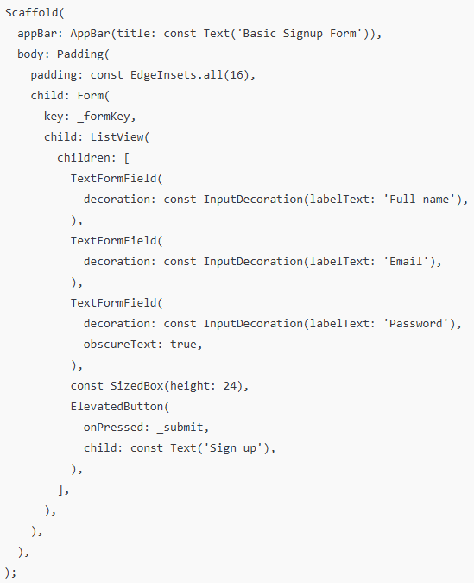
Basic Signup Form - Structure
Minimal signup screen structure
Scaffold
AppBar
Form with _formKey
TextFormFields for name, email, password
A submit button
Notes:
Demo: BasicSignupScreen – shows students the layout before adding logic.

Slide 8
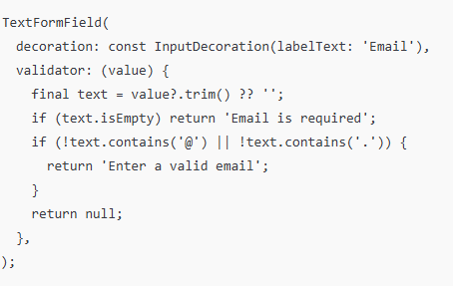
Basic Signup Form - Built-in Validators
The validator function
Signature: String? Function(String? value)
If valid → return null
If invalid → return error message (String)
Common checks:
Required field (not empty)
Email format (contains @ and .)
Minimum length
Notes:
Demo: BasicSignupScreen – highlights the error displayed below the TextFormField after clicking submit.

Slide 9
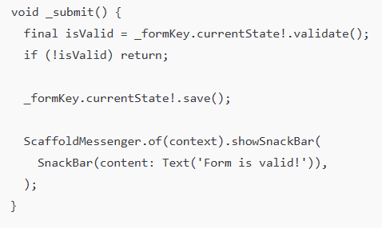
Basic Signup Form - Submit Flow & Button State
Typical submit flow:
User taps Submit
Call validate()
If valid → call save() and submit data
If invalid → show inline errors
Display error when form invalid
Display SnackBar when valid
“FormState standard” Submit logic
(Simple submit flow → validate → save → SnackBar
Notes:
Reminder: the full demo will add async check & loading.
Demo 7.1 – BasicSignupScreen

Slide 10
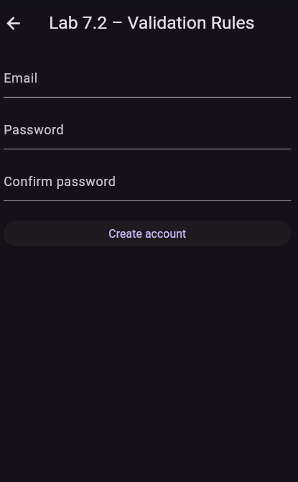
Demo 2 - Validation Rules
Goal: Add strong password + confirm password logic.
Requirements:
Password ≥ 8 chars & includes number
Confirm password must match
Use helper validator functions
Enable AutovalidateMode.onUserInteraction
Notes:
Code demo Lab 7.2 Validation Rules (Password + Confirm Password)
import 'package:flutter/material.dart';
void main() => runApp(const Lab72App());
class Lab72App extends StatelessWidget {
const Lab72App({super.key});
@override
Widget build(BuildContext context) {
return MaterialApp(
title: 'Lab 7.2 – Validation Rules',
theme: ThemeData.dark(useMaterial3: true),
debugShowCheckedModeBanner: false,
home: const ValidationSignupScreen(),
);
}
}
class ValidationSignupScreen extends StatefulWidget {
const ValidationSignupScreen({super.key});
@override
State<ValidationSignupScreen> createState() => _ValidationSignupScreenState();
}
class _ValidationSignupScreenState extends State<ValidationSignupScreen> {
final _formKey = GlobalKey<FormState>();
String _email = '';
String _password = '';
String _confirmPassword = '';
@override
Widget build(BuildContext context) {
return Scaffold(
appBar: AppBar(title: const Text("Lab 7.2 – Validation Rules")),
body: Padding(
padding: const EdgeInsets.all(16),
child: Form(
key: _formKey,
autovalidateMode: AutovalidateMode.onUserInteraction,
child: ListView(
children: [
TextFormField(
decoration: const InputDecoration(labelText: "Email"),
keyboardType: TextInputType.emailAddress,
onChanged: (v) => _email = v.trim(),
validator: _validateEmail,
),
const SizedBox(height: 16),
TextFormField(
decoration: const InputDecoration(labelText: "Password"),
obscureText: true,
onChanged: (v) => _password = v,
validator: _validatePassword,
),
const SizedBox(height: 16),
TextFormField(
decoration: const InputDecoration(labelText: "Confirm Password"),
obscureText: true,
onChanged: (v) => _confirmPassword = v,
validator: _validateConfirmPassword,
),
const SizedBox(height: 24),
ElevatedButton(
onPressed: _submit,
child: const Text("Create account"),
),
],
),
),
),
);
}
// VALIDATION FUNCTIONS
String? _validateEmail(String? value) {
final text = value?.trim() ?? '';
if (text.isEmpty) return "Email is required";
if (!text.contains("@") || !text.contains(".")) {
return "Enter a valid email";
}
return null;
}
String? _validatePassword(String? value) {
final text = value ?? '';
if (text.isEmpty) return "Password is required";
if (text.length < 8) return "Use at least 8 characters";
if (!text.contains(RegExp(r"[0-9]"))) return "Include a number";
return null;
}
String? _validateConfirmPassword(String? value) {
if (value == null || value.isEmpty) return "Please confirm password";
if (value != _password) return "Passwords do not match";
return null;
}
void _submit() {
if (!_formKey.currentState!.validate()) return;
ScaffoldMessenger.of(context).showSnackBar(
SnackBar(content: Text("Account created for $_email")),
);
}
}

Slide 11
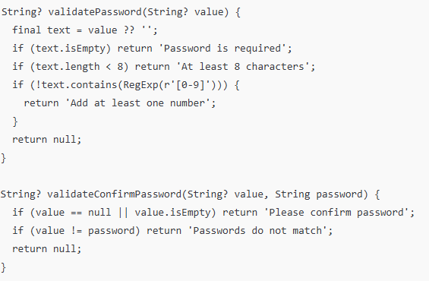
Demo 2 - Custom Validation Rules
Use custom validators for:
Business rules (username rules, banned words)
Password strength (length, numbers, symbols)
More advanced email checks (pattern / regex)
Notes:
Demo: ValidationSignupScreen – point to _validatePassword & _validateConfirmPassword.

Slide 12
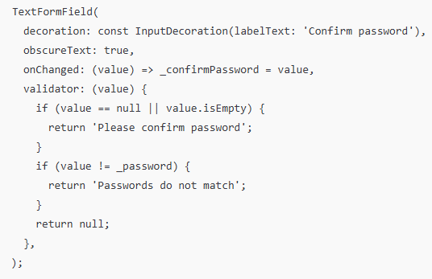
Demo 2 - Confirm Password Logic
Why confirm password?
Prevent typos
Improve user confidence
Pattern:
Keep _password in state
Compare confirm password with _password
Show error if they differ
Notes:
Focus on the mindset: “always compare to state, not to other text controllers in validators (for neatness)”.

Slide 13
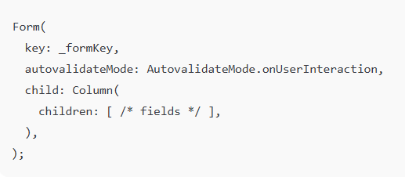
Demo 2 - AutovalidateMode
Autovalidate modes:
AutovalidateMode.disabled
AutovalidateMode.always
AutovalidateMode.onUserInteraction (recommended)
UX trade-offs:
Too early → annoying (red errors everywhere from the start)
Too late → confusing (errors appear only after submit)
Notes:
Demo: ValidationSignupScreen – toggle between disabled and onUserInteraction for student to feel.

Slide 14
Error Messages & UX
Good error messages:
Short and clear
Specific to the field
Polite and helpful
Examples:
“Enter a valid email”
“Password must be at least 8 characters”
“ERROR_400_INVALID_FIELD”
Best practices:
Show error under the field
Avoid blaming language
Highlight only relevant fields
Notes:
Demo 7.2 Validation Rules has autovalidate, inline errors, password rules, confirm password, suitable for illustrating how to write good/bad error messages

Slide 15
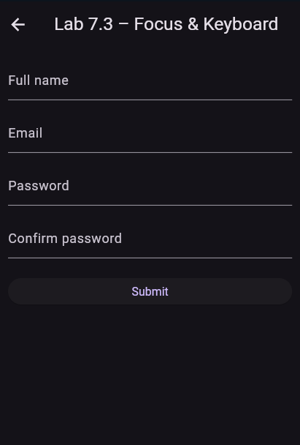
Demo 3 - Focus & Keyboard UX
Goal:
Improve input experience on mobile.
Requirements:
Create FocusNode for each field
Use Next/Done with textInputAction
Move focus using onFieldSubmitted
Dismiss keyboard using GestureDetector
Wrap form with ListView to prevent overflow

Slide 16
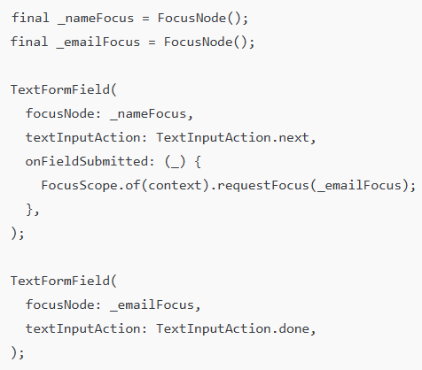
Demo 3 - Managing Focus & Keyboard Content
Why manage focus?
Mobile keyboards can hide fields
Users expect Next/Done to work smoothly
Tools:
FocusNode
textInputAction
onFieldSubmitted
FocusScope.of(context).requestFocus(nextFocusNode)
Notes:
Demo: FocusFormScreen – tap on device/simulator for student to see Next/Done to transfer school.

Slide 17
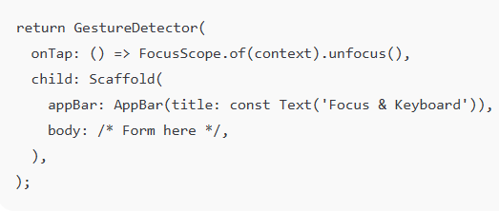
Demo 3 - Dismissing the Keyboard
Common UX requirement:
Tap outside the form → keyboard hides
Pattern: Wrap with GestureDetector
Also:
Wrap form in ListView or SingleChildScrollView to avoid overflow.
Notes:
Demo: FocusFormScreen – tap outside field để bàn phím ẩn.

Slide 18
Form Layout Patterns
Common layouts:
Single-page scrollable form
Grouped sections (e.g. Personal Info / Account Info)
Multi-step wizard (optional, conceptual)
Avoid:
Too many fields on screen without grouping
Keyboard covering the submit button
Fixed height containers that don’t scroll
Notes:
Demo 7.3 – FocusFormScreen, using ListView to avoid overflow, using Scroll + Keyboard UX → good illustration of layout patterns

Slide 19
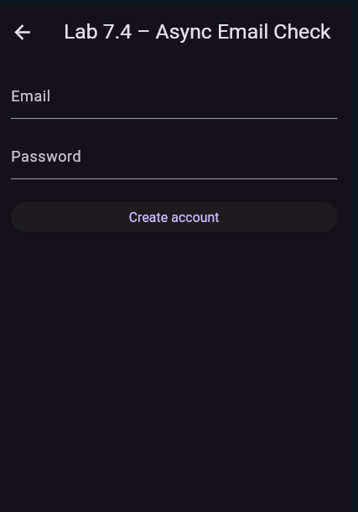
Demo 4 - Async Email Check (Optional)
Goal:
Simulate server-side validation before account creation.
Requirements
Validate form locally
Show loading state during async check
Delay 2s: Future.delayed()
If email starts with “taken” → show error: “Email already taken”
Disable Submit button during check
Notes:
Code demo : Async Email Check (Optional)
import 'package:flutter/material.dart';
void main() => runApp(const Lab74App());
class Lab74App extends StatelessWidget {
const Lab74App({super.key});
@override
Widget build(BuildContext context) {
return MaterialApp(
title: 'Lab 7.4 – Async Email Check',
theme: ThemeData.dark(useMaterial3: true),
debugShowCheckedModeBanner: false,
home: const AsyncValidationScreen(),
);
}
}
class AsyncValidationScreen extends StatefulWidget {
const AsyncValidationScreen({super.key});
@override
State<AsyncValidationScreen> createState() => _AsyncValidationScreenState();
}
class _AsyncValidationScreenState extends State<AsyncValidationScreen> {
final _formKey = GlobalKey<FormState>();
String _email = '';
String _password = '';
bool _isChecking = false;
@override
Widget build(BuildContext context) {
return Scaffold(
appBar: AppBar(title: const Text("Lab 7.4 – Async Email Check")),
body: Padding(
padding: const EdgeInsets.all(16),
child: Form(
key: _formKey,
autovalidateMode: AutovalidateMode.onUserInteraction,
child: ListView(
children: [
TextFormField(
decoration: const InputDecoration(labelText: "Email"),
keyboardType: TextInputType.emailAddress,
onChanged: (v) => _email = v.trim(),
validator: _validateEmail,
),
const SizedBox(height: 16),
TextFormField(
decoration: const InputDecoration(labelText: "Password"),
obscureText: true,
onChanged: (v) => _password = v,
validator: (v) =>
v == null || v.isEmpty ? "Password required" : null,
),
const SizedBox(height: 24),
ElevatedButton(
onPressed: _isChecking ? null : _submit,
child: _isChecking
? const SizedBox(
width: 18,
height: 18,
child: CircularProgressIndicator(strokeWidth: 2),
)
: const Text("Create account"),
),
],
),
),
),
);
}
String? _validateEmail(String? value) {
final text = value?.trim() ?? '';
if (text.isEmpty) return "Email is required";
if (!text.contains("@") || !text.contains(".")) {
return "Enter a valid email";
}
return null;
}
Future<void> _submit() async {
if (!_formKey.currentState!.validate()) return;
setState(() => _isChecking = true);
// Fake server delay
await Future.delayed(const Duration(seconds: 2));
final isTaken = _email.toLowerCase().startsWith("taken");
setState(() => _isChecking = false);
if (isTaken) {
ScaffoldMessenger.of(context).showSnackBar(
const SnackBar(content: Text("This email is already taken")),
);
return;
}
ScaffoldMessenger.of(context).showSnackBar(
SnackBar(content: Text("Account created for $_email")),
);
}
}

Slide 20
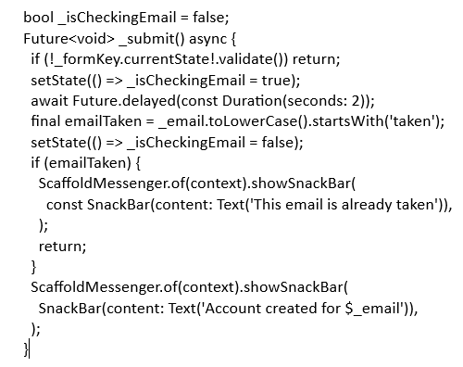
Async Email Check (Optional)
Why async validation?
Check if email/username already exists
Validate codes or coupons
Confirm availability (e.g. booking slot)
Pattern (simplified):
Notes:
Demo: AsyncValidationScreen hoặc FullSignupScreen – highlight việc disable nút trong khi chờ.

Slide 21
From Form to Backend (Suggested Content)
What happens after validation?
User fills the form
Local validation checks (Module 7)
Send data via API (Module 8)
Server performs deeper checks
Server returns success/error
UI updates accordingly
UI Form → Validation → POST Request → Server → Response → UI Update
Notes:
“This slide helps students see how client-side validation fits into a full signup process. Actual backend and API integration will be covered in Module 8.”

Slide 22
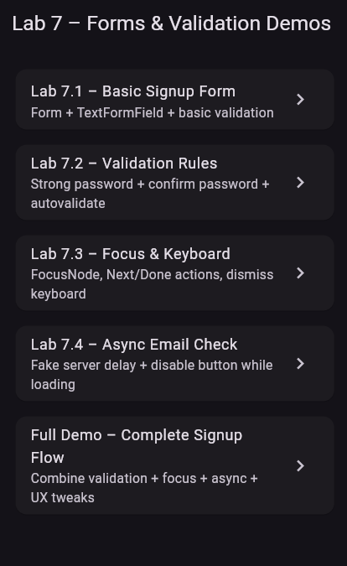
Full Signup Demo (Combined)
Features combined:
Name, email, password, confirm password
Built-in + custom validation
Autovalidate on user interaction
Focus management (Next/Done)
Show/hide password
Async email check with loading button
Notes:
Note:
Students synthesize lab exercises from 7.1 - 7.4 to complete the project

Slide 23
Lab Forms & Validation
Lab 7 – Forms & Validation
Lab 7.1 – Basic registration form
Lab 7.2 – Validation rules & password strength
Lab 7.3 – Focus & keyboard management
Lab 7.4 – Optional async email check
You will:
Implement the signup form step by step
Run it on DartPad and on emulator/device
Capture screenshots and submit your code

Slide 24
Summary
In this module, you learned how to:
Build forms using Form and TextFormField
Use FormState to validate, save, and reset data
Implement required fields and custom validation rules
Manage focus and keyboard interactions on mobile
Show clear error messages and success feedback
Combine everything into a complete signup form

Slide 25
References
Mastering Flutter 2025 – Ch.4, 14
docs.flutter.dev
https://dartpad.dev

